Slide 1

Conquering the Windy City
Leveraging Analytics in the Chicago Rental Market
Michelle Chen, Hans Han, John Hu, Trishal Patel, and Max Santa Ana
© 2015 RentPath, LLC. All rights reserved.

Slide 2


Roadmap
Problem Overview
Business Understanding
Recommendation
Descriptive Analytics
Predictive Analytics

Slide 3



RentPath operates in a two-sided market place
30k subscriptions &
100k property inventory
14.7M
unique, monthly visitors
Customers
Consumers
Problem Overview
Business Understanding
Predictive Analytics
Descriptive Analytics
Recommendations

Slide 4
RentPath converts consumers into leads for customers
Business Understanding
Business Environment
Two-sided marketplace
Converting consumers into leads for customers (rental property managers)
Customers in return purchase subscription packages from RentPath to advertise properties on the company’s affiliated sites (e.g., ApartmentGuide)
Problem Overview
Business Understanding
Predictive Analytics
Descriptive Analytics
Recommendations

Slide 5
The revisit rate for Chicago is 25.52%
First-Time Visitors
Churn
74.48%
Lead
3.38%
No Lead
96.62%
Revisit
25.52%
Lead
5.78%
No Lead
94.22%
Problem Overview
Business Understanding
Predictive Analytics
Descriptive Analytics
Recommendations

Slide 6
The revisit rate for Chicago is 25.52%
First-Time Visitors
Churn
74.48%
Lead
3.38%
No Lead
96.62%
Revisit
25.52%
Lead
5.78%
No Lead
94.22%
Problem Overview
Business Understanding
Predictive Analytics
Descriptive Analytics
Recommendations

Slide 7
Likelihood of leaving a lead improves given revisit
First-Time Visitors
Churn
74.48%
Lead
3.38%
No Lead
96.62%
Revisit
25.52%
Lead
5.78%
No Lead
94.22%
Problem Overview
Business Understanding
Predictive Analytics
Descriptive Analytics
Recommendations

Slide 8
Targeted ads increases potential revisitor value by 15%
Actual Churn
Actual Still Looking
$0.50 /consumer
$0.00
Predicted Churn
($.025)/ad
$0.575 /consumer
Predicted Still
Looking
Problem Overview
Business Understanding
Predictive Analytics
Descriptive Analytics
Recommendations

Slide 9

Targeted ads increases potential revisitor value by 15%
Actual Churn
Actual Still Looking
$0.50 /consumer
$0.00
Predicted Churn
Increase in potential revisitor’s value from
$0.50 to $0.575
($.025)/ad
$0.575 /consumer
Predicted Still
Looking
Problem Overview
Business Understanding
Predictive Analytics
Descriptive Analytics
Recommendations

Slide 10


Three models achieved high accuracy and product recall
Random Forest
Bagged Random Forest
Bagging
Repeated Validation
Problem Overview
Business Understanding
Predictive Analytics
Descriptive Analytics
Recommendations
Notes:
While we trialed a variety of predictive analytics techniques during the modeling process, we found that there were three models that stood out in terms of accuracy (robustness of our model) and product recall, which also especially important when it comes to predicting first time visitors who are likely to revisit or churners (who are done looking).
These three models are the random forest model, bootstrap aggregation (or bagging), and bootstrap aggregation combined with a random forest model.
Often times the way that our data set was split into training and testing, could affect our these measures. Therefore we went ahead and split validated our models to see if the accuracy and recall product was consistent with our original results.
During split validation, we were left with five new training/testing sets that had been randomly split based on a set seed. ran our models using these newly split data sets.
Took an average of the accuracies. And out the three models, we chose the model with the greatest average accuracy and highest product recall, which ended up being the Bootstrap aggregation model, which yielded a 65.4% model accuracy and 37.7% product recall.

Slide 11
Three models achieved high accuracy and product recall
Random Forest
Bagged Random Forest
Bagging
Repeated Validation
Problem Overview
Business Understanding
Predictive Analytics
Descriptive Analytics
Recommendations
Notes:
While we trialed a variety of predictive analytics techniques during the modeling process, we found that there were three models that stood out in terms of accuracy (robustness of our model) and product recall, which also especially important when it comes to predicting first time visitors who are likely to revisit or churners (who are done looking).
These three models are the random forest model, bootstrap aggregation (or bagging), and bootstrap aggregation combined with a random forest model.
Often times the way that our data set was split into training and testing, could affect our these measures. Therefore we went ahead and split validated our models to see if the accuracy and recall product was consistent with our original results.
During split validation, we were left with five new training/testing sets that had been randomly split based on a set seed. ran our models using these newly split data sets.
Took an average of the accuracies. And out the three models, we chose the model with the greatest average accuracy and highest product recall, which ended up being the Bootstrap aggregation model, which yielded a 65.4% model accuracy and 37.7% product recall.

Slide 12


Bootstrap Aggregation (Bagging) yields 65.4% model accuracy
65.4% Accuracy
37.7% Product Recall
Problem Overview
Business Understanding
Predictive Analytics
Descriptive Analytics
Recommendations
Notes:
While we trialed a variety of predictive analytics techniques during the modeling process, we found that there were three models that stood out in terms of accuracy (robustness of our model) and product recall, which also especially important when it comes to predicting first time visitors who are likely to revisit or churners (who are done looking).
These three models are the random forest model, bootstrap aggregation (or bagging), and bootstrap aggregation combined with a random forest model.
Often times the way that our data set was split into training and testing, could affect our these measures. Therefore we went ahead and split validated our models to see if the accuracy and recall product was consistent with our original results.
During split validation, we were left with five new training/testing sets that had been randomly split based on a set seed. ran our models using these newly split data sets.
Took an average of the accuracies. And out the three models, we chose the model with the greatest average accuracy and highest product recall, which ended up being the Bootstrap aggregation model, which yielded a 65.4% model accuracy and 37.7% product recall.

Slide 13


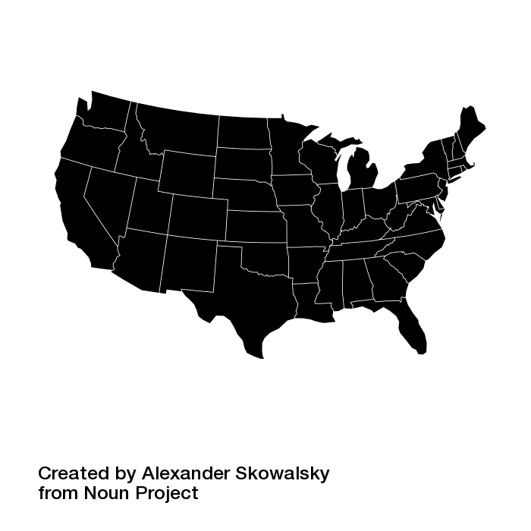
Validated model generates an annual net benefit of $780,000
Chicago, Illinois
$100,800
$780,000
Problem Overview
Business Understanding
Predictive Analytics
Descriptive Analytics
Recommendations
Notes:
With our validated bagging model, we are able to achieve a net benefit of 100,800 dollars per year just for just searches limited to city of Chicago Illinois,
However, further Extrapolating our Chicago model to 14.7 million visitors per month in the entire US, the annual net benefit for RentPath is $780,000

Slide 14

An alternative perspective on the problem objective . . .
Discovering associations
between rental properties
:
Problem Overview
Business Understanding
Predictive Analytics
Descriptive Analytics
Recommendations

Slide 15
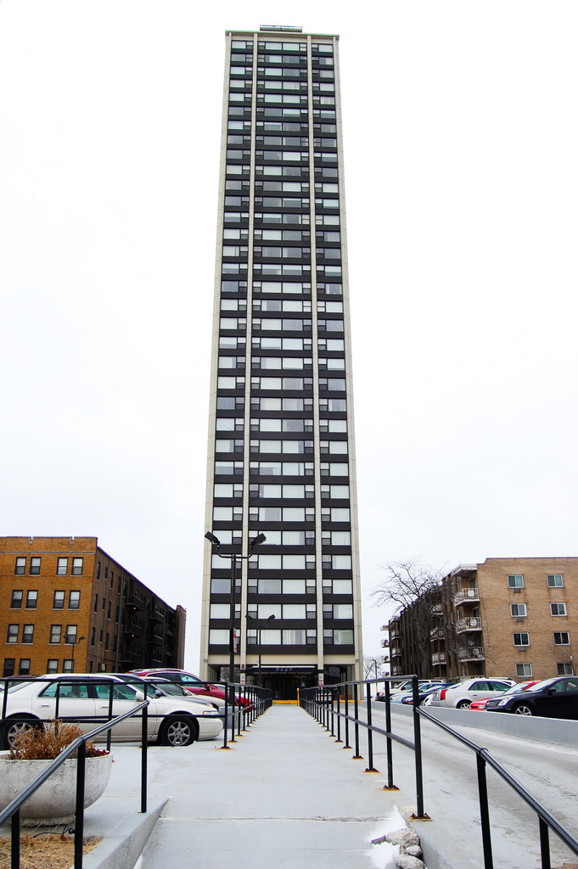
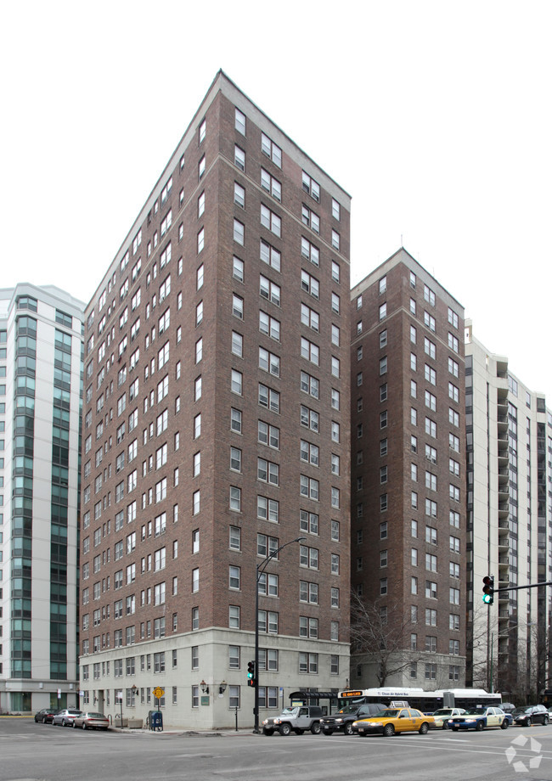
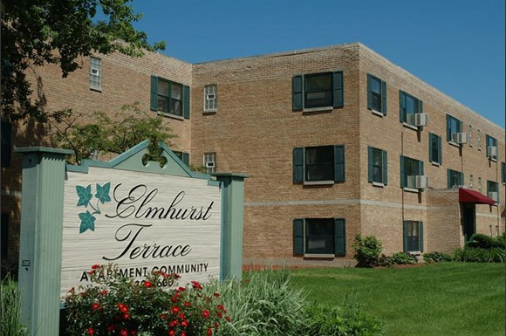
Association Rule Mining yields marginal revenue of $52,000
from additional website visits
73rd Street Apartments - 7345 South South Shore Drive, Chicago, IL 60649 & 7300
Venture Apartment Homes - 7300 S South Shore Drive, Chicago, IL 60649
South Shore Beach Apartments - 7447 South Shore Drive, Chicago, IL 60649
Atrium Village - 300 West Hill Street, Chicago, IL 60610 &
Dearborn Plaza Apartments - 1030 North
1100 North LaSalle - 1100 North Lasalle, Chicago, IL 60610
Briarton Place Apartments - 25 Briar Street, Glen Ellyn, IL 60137
Param Apartments - 1637 South Michigan Avenue, Villa Park, IL 60181
Elmhurst Terrace - 100 Fellows Court, Elmhurst, IL 60126
Problem Overview
Business Understanding
Predictive Analytics
Descriptive Analytics
Recommendations
Notes:
gfgWe recommend using the top 10 association rules to recommend properties to consumers, leading to a potential $41,000 to $62,000 worth of online property visits per year, based on 40% to 60% conversion

Slide 16
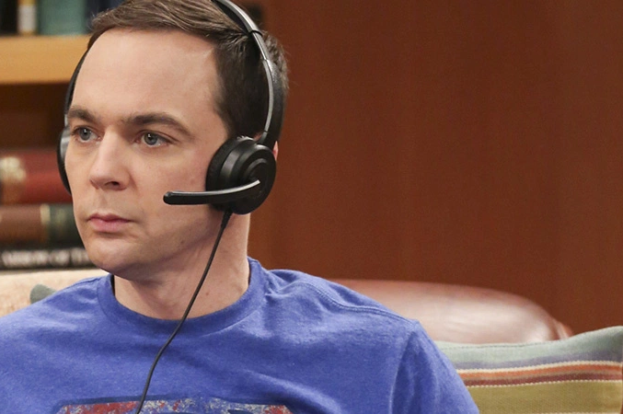

Targeted Facebook ads for smartphone users capitalizes on attractive opportunities
Clustering analysis reveals 3 major visitor groups
Scientific Sheldon
Android smartphone users, tech savvy
More in-depth searcher, more time spent on page
Lower income, but likely has a technical degree
Actions
More refined search parameters
More choice & selection using association rule mining and invert rule mining (i.e. provide most likely as well as least likely to visit to increase search pool)
Problem Overview
Business Understanding
Predictive Analytics
Descriptive Analytics
Recommendations
5

Slide 17

Targeted Facebook ads for smartphone users capitalizes on attractive opportunities
Clustering analysis reveals 3 major visitor groups
Lonely Lionel
Windows desktop user
More likely to visit during weekdays
Looks for 1 bedroom, pet-friendly, short-term locations
Actions:
Provide more targeted ads using association rule mining for single bedroom apartments to increase retention time
Problem Overview
Business Understanding
Predictive Analytics
Descriptive Analytics
Recommendations
5

Slide 18

Targeted Facebook ads for smartphone users capitalizes on attractive opportunities
Clustering analysis reveals 3 major visitor groups
Modern Michelle
iOS user
A mixed use of phones & tablets
More likely to visit on weekends
More interaction with apps, cares about user friendliness
Wealthier, have a higher degree
Actions:
App development to increase app engagement
Problem Overview
Business Understanding
Predictive Analytics
Descriptive Analytics
Recommendations
5

Slide 19
Three-Pronged Analytics Approach results in $832,000
annually of additional revenue for RentPath
Predictive Modeling
Associative Rule Mining
Clustering
Better understanding of consumer segments
Reveals 3 distinct consumer groups
Determine which properties are viewed together
Use internal recommendation engine to suggest other properties
+ $52,000
Predict likely revisitors
Target revisitors using Facebook ads
+ $780,000
$832,000
Problem Overview
Business Understanding
Predictive Analytics
Descriptive Analytics
Recommendations
Notes:
gfgWe recommend using the top 10 association rules to recommend properties to visitors, leading to a potential $41,000 to $62,000 worth of online property visits per year, based on 40% to 60% conversion

Slide 20
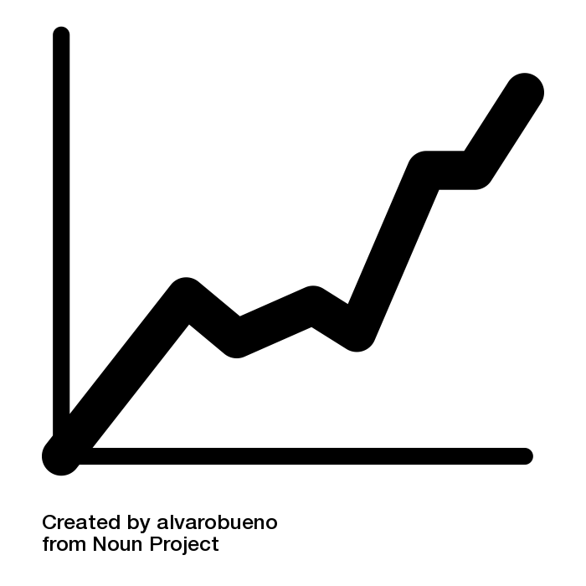


Success of recommendation can be tracked through measurable KPIs
Increase in the 25% average revisit rate for ApartmentGuides
Reduction in the average time between website revisits
Growth in conversion of revisits to leads - currently 5.8%
Problem Overview
Business Understanding
Predictive Analytics
Descriptive Analytics
Recommendations
Notes:
gfgWe recommend using the top 10 association rules to recommend properties to visitors, leading to a potential $41,000 to $62,000 worth of online property visits per year, based on 40% to 60% conversion

Slide 21

Implement a dynamic model to incorporate incoming
consumer clickthrough data
A static model is difficult to accurately predict a diverse user base
Update and optimize model to reflect such user base changes
The model needs to be dynamic, a “living” model
Problem Overview
Business Understanding
Predictive Analytics
Descriptive Analytics
Recommendations
Notes:
gfgWe recommend using the top 10 association rules to recommend properties to visitors, leading to a potential $41,000 to $62,000 worth of online property visits per year, based on 40% to 60% conversion

Slide 22

Q&A

Slide 23
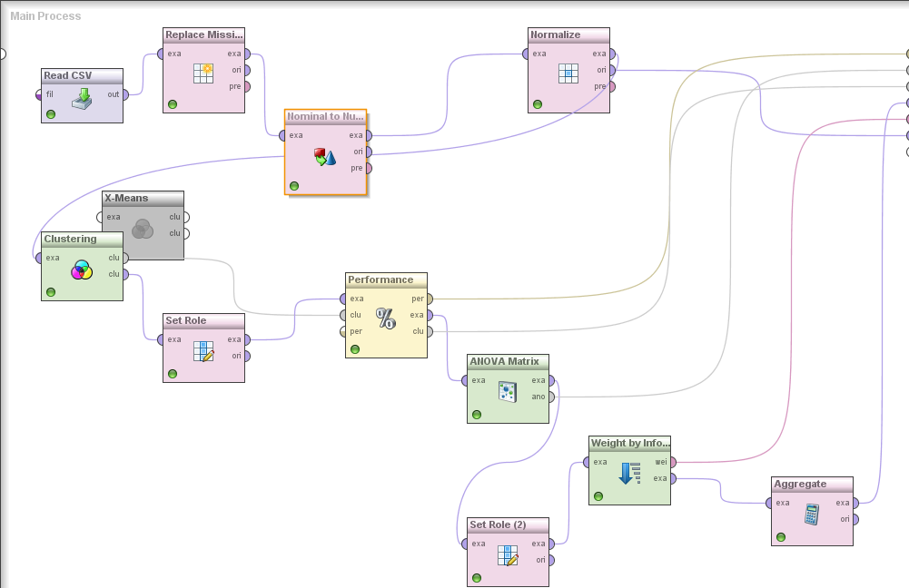
APPENDIX 1: Clustering Process

Slide 24
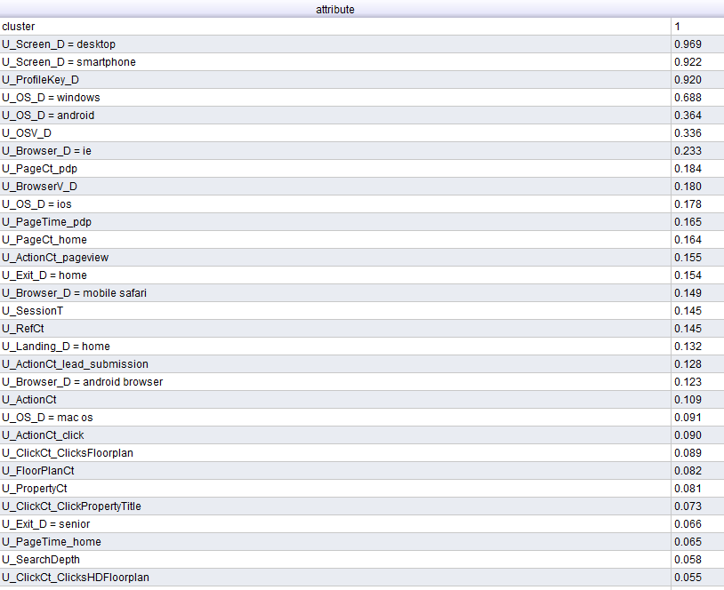
APPENDIX 2: Feature weighting from clustering process

Slide 25
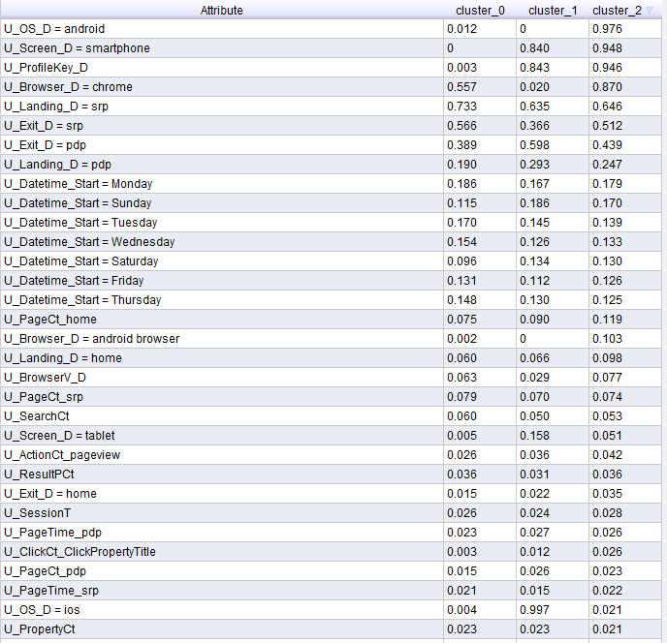
APPENDIX 3: Centroid table

Slide 26
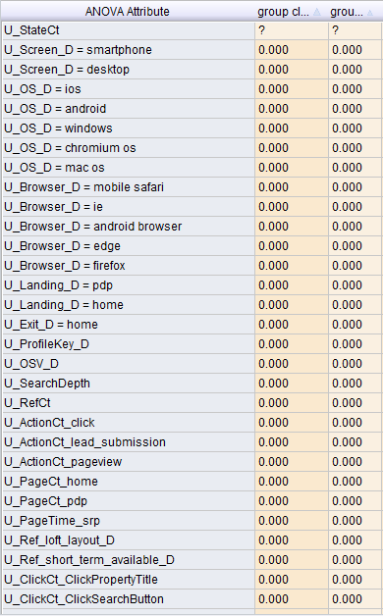
APPENDIX 4: ANOVA table from clustering

Slide 27
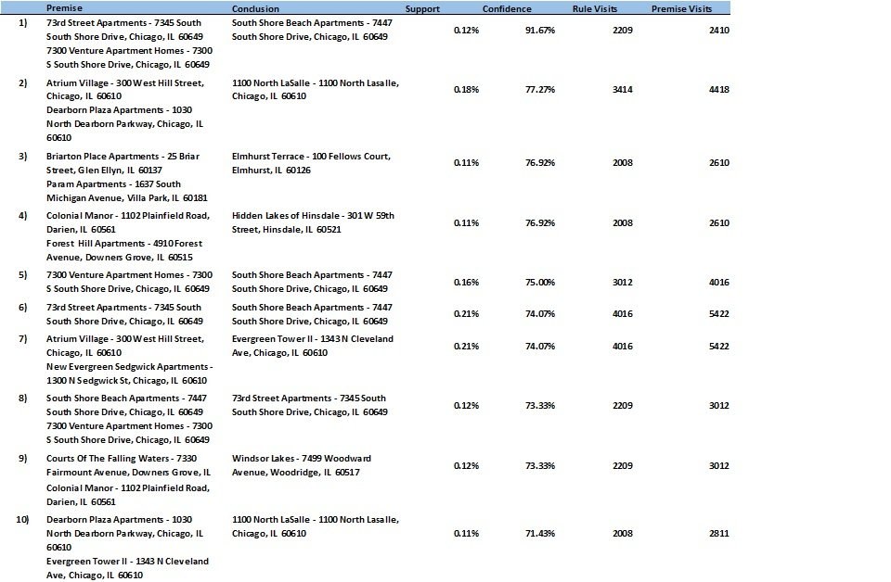
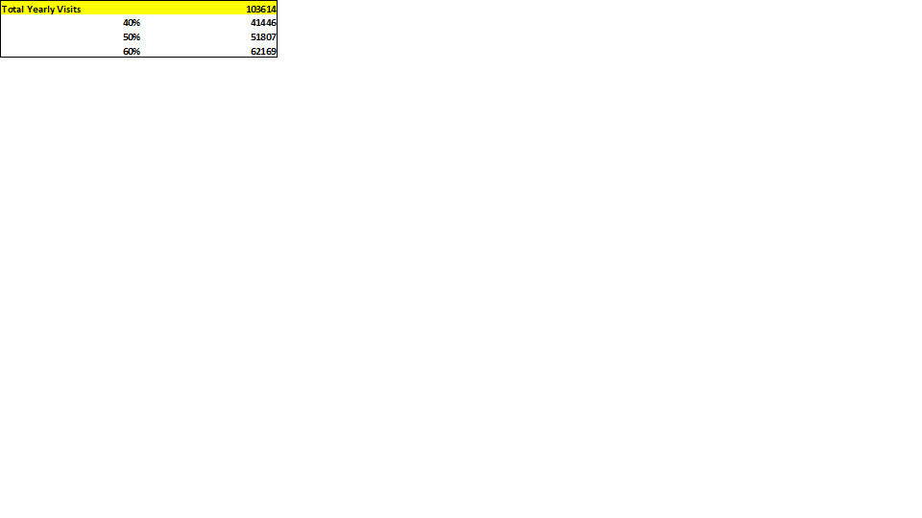
APPENDIX 5: Top 10 associations for the Chicago market

Slide 28
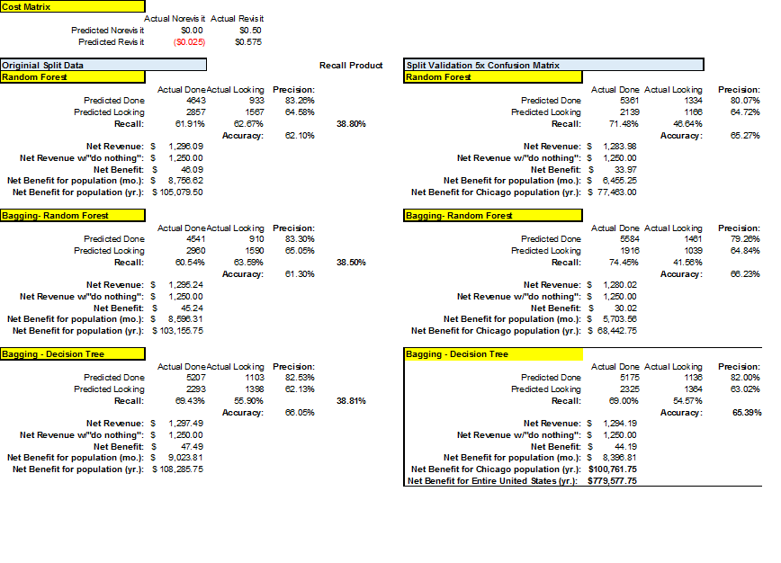
APPENDIX 6: Cost-benefit analysis of predictive models

